Slide 1
Quality Control Troubleshooting
6.25.24 version 1.0

Slide 2
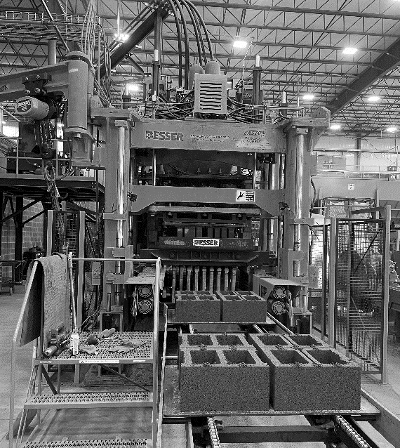
Assumptions and Prerequisite Skills
The computer is on and IntelliBatch 3.0 is open
Supplies Needed
Standard PPE
Air hose with chisel extension (possibly)

Slide 3
Preface
When you see a pallet with quality issues, stand by to see if there are more pallets coming with the same misconfiguration. A quality issue on a pallet may just be caused by auto feed working too fast and needing to adjust. If this is the case, the auto feed feature usually fixes itself and the pallets will go back to normal within a short time. Remember to only eject a pallet if more than one block is insufficient. If you conclude that there is another cause of these bad pallets evaluate the type of problem:

Slide 4
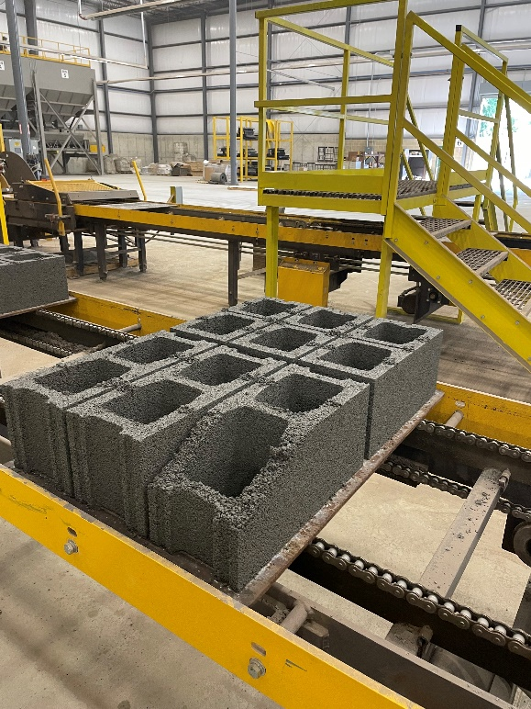
Quality Defect: Edge Filling
If you see one side consistently not being filled up, this may mean that the mud hopper belt is moving either too slow or fast (Figure 1). If there is not enough material on the left side of the pallet, the belt is moving too slow. If there is not enough material on the right side of the pallet, the belt is moving too fast.
Figure 1

Slide 5
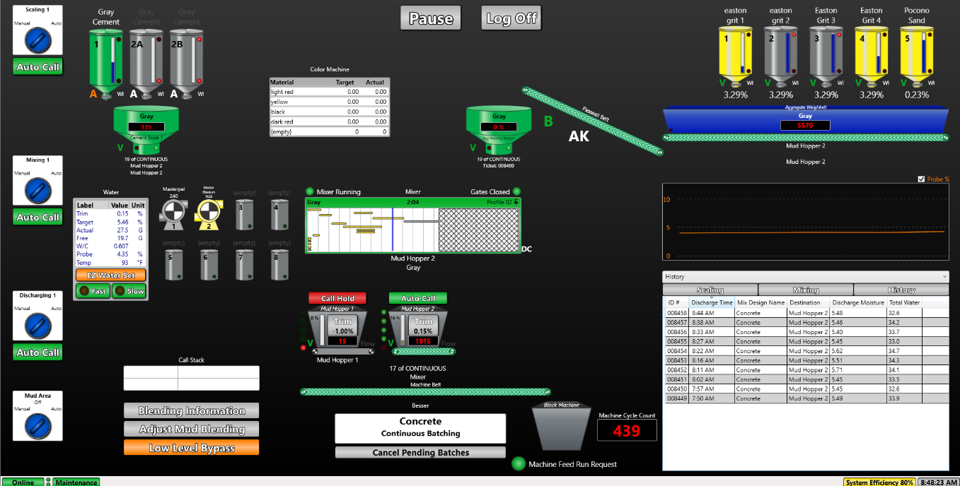
Edge Filling
1. Go to IntelliBatch 3.0 and select the “Adjust Mud Blending” button on the “Main View” page (Red circle in Figure 2)
Figure 2

Slide 6
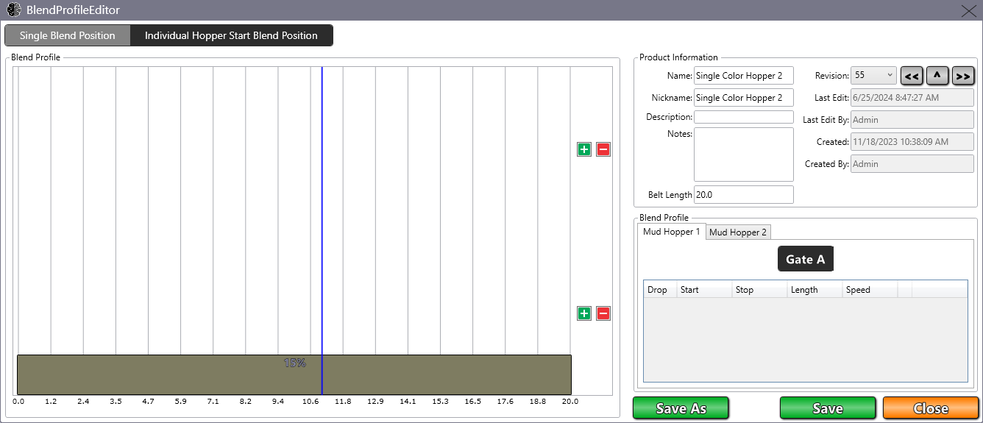
Edge Filling
2. Click on the Mud Hopper 2 tab (Blue circle in Figure 3)
Figure 3

Slide 7
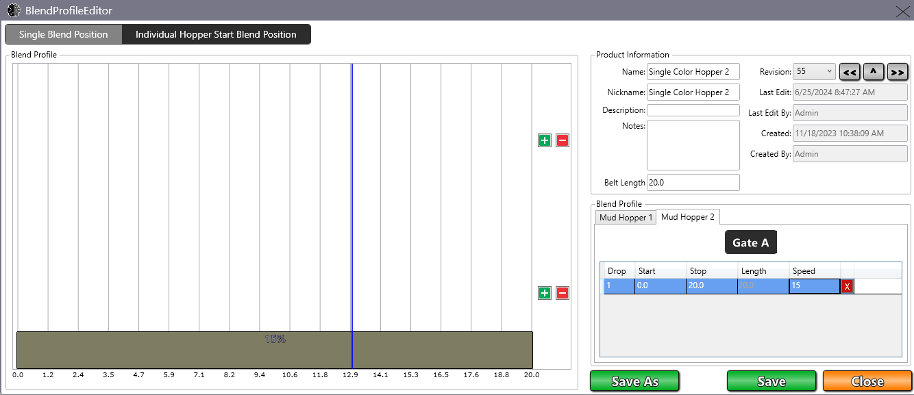
Edge Filling
3. Click on the box under “Speed” to increase/decrease the value by at most 2 units(Figure 4)
Click the “Save” button and click the “Close” button
Figure 4

Slide 8
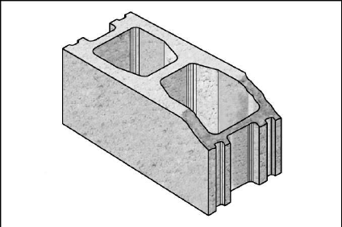
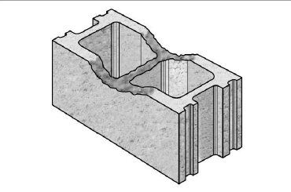
Quality Defect: General Filling Issues
If the pallet in general seems to be missing material at the top (Figure 5), this may be due to wet content mixture
Figure 5

Slide 9
Quality Defect: General Filling Issues

Slide 10
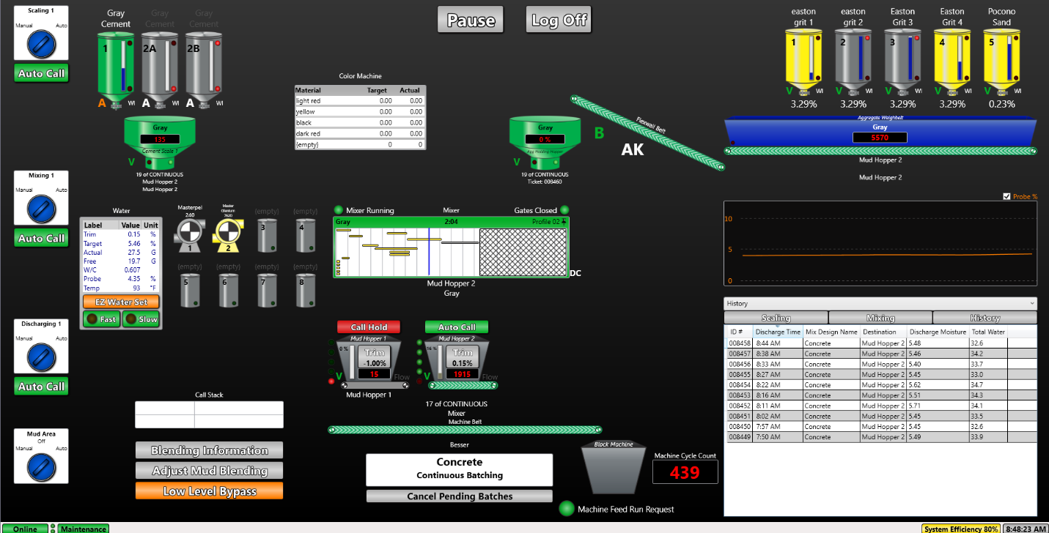
General Filling: Wet Material
1. Check your Batch history on IntelliBatch 3.0 (Red square in Figure 5). Compare the last two columns to the data on the “Water” chart (Purple square in Figure 6) on the left side of the “Main View” page. If the Discharge Moisture from the last batch is above .15% of the “Target” percentage from the water table, This likely means your batch is too wet. If this is the case, proceed to the next step. Otherwise, go to Quality Defect 3
Figure 6

Slide 11
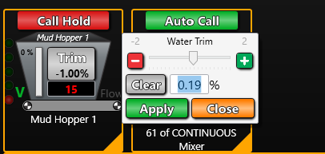
General Filling: Wet Material
2. Click on the “Trim” button in the center of the page and drop the value .03% per batch (Figure 7). You can tell when a batch has cycled by checking the “Discharge Time” column in the history chart (red square) from Figure 6.
3. If this works, monitor a few more cycles. If this does not work, move on to General Filling: Clogged Mold
Figure 7

Slide 12
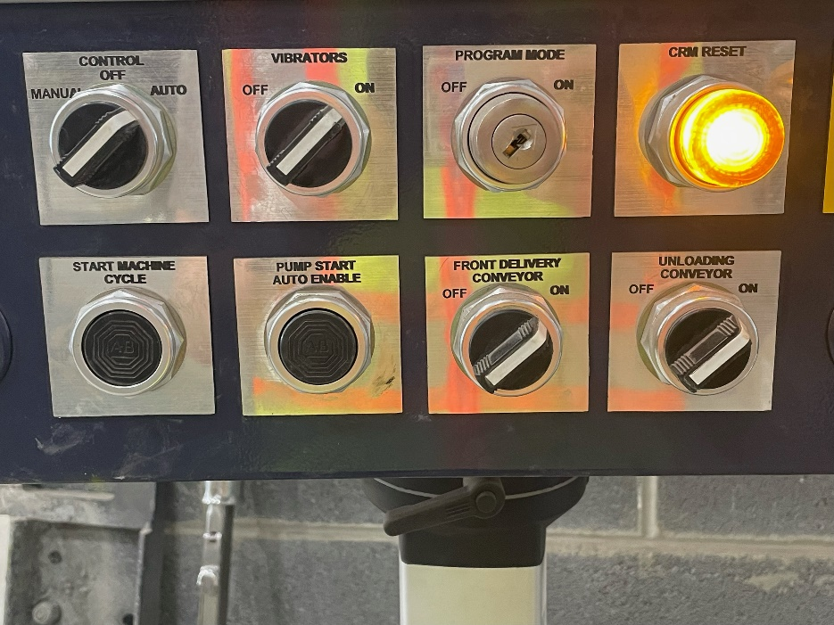
General Filling: Mold Material Build-up
The cause of the bad pallets may be material remaining in the mold. This means the mixture has dried and stuck to mold liners, core assemblies, mold top-plate, etc.
1. Start off by switching the Control switch to the “Manual” position (Figure 8)
Figure 8

Slide 13
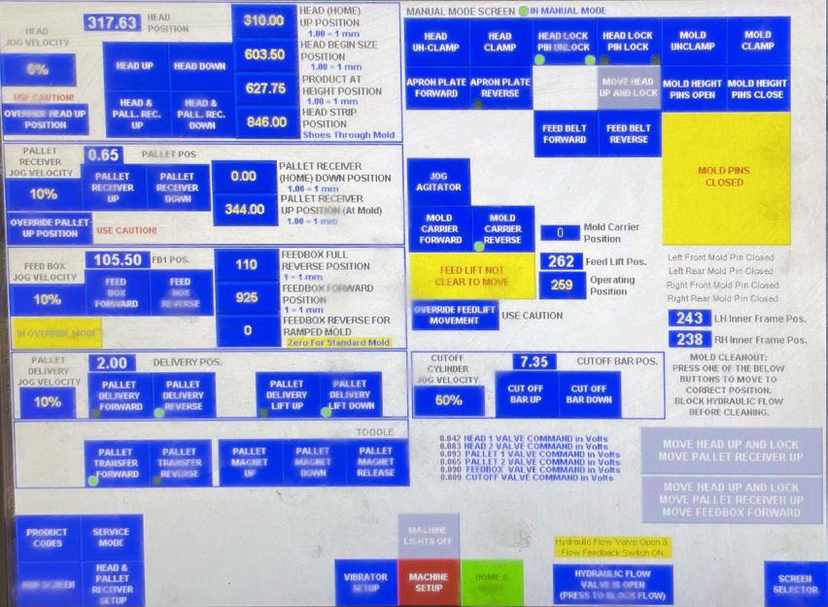
General Filling: Mold Material Build-up
2. Press and hold on the “Head Up” button on the HMI monitor until the head can no longer go up (Red circle in Figure 9).
3. If the feedbox is forward, press and hold on the “Feedbox Reverse” button until the feedbox can no longer move back (green circle in Figure 9). If the feedbox is already back, proceed to the next step
Figure 9

Slide 14
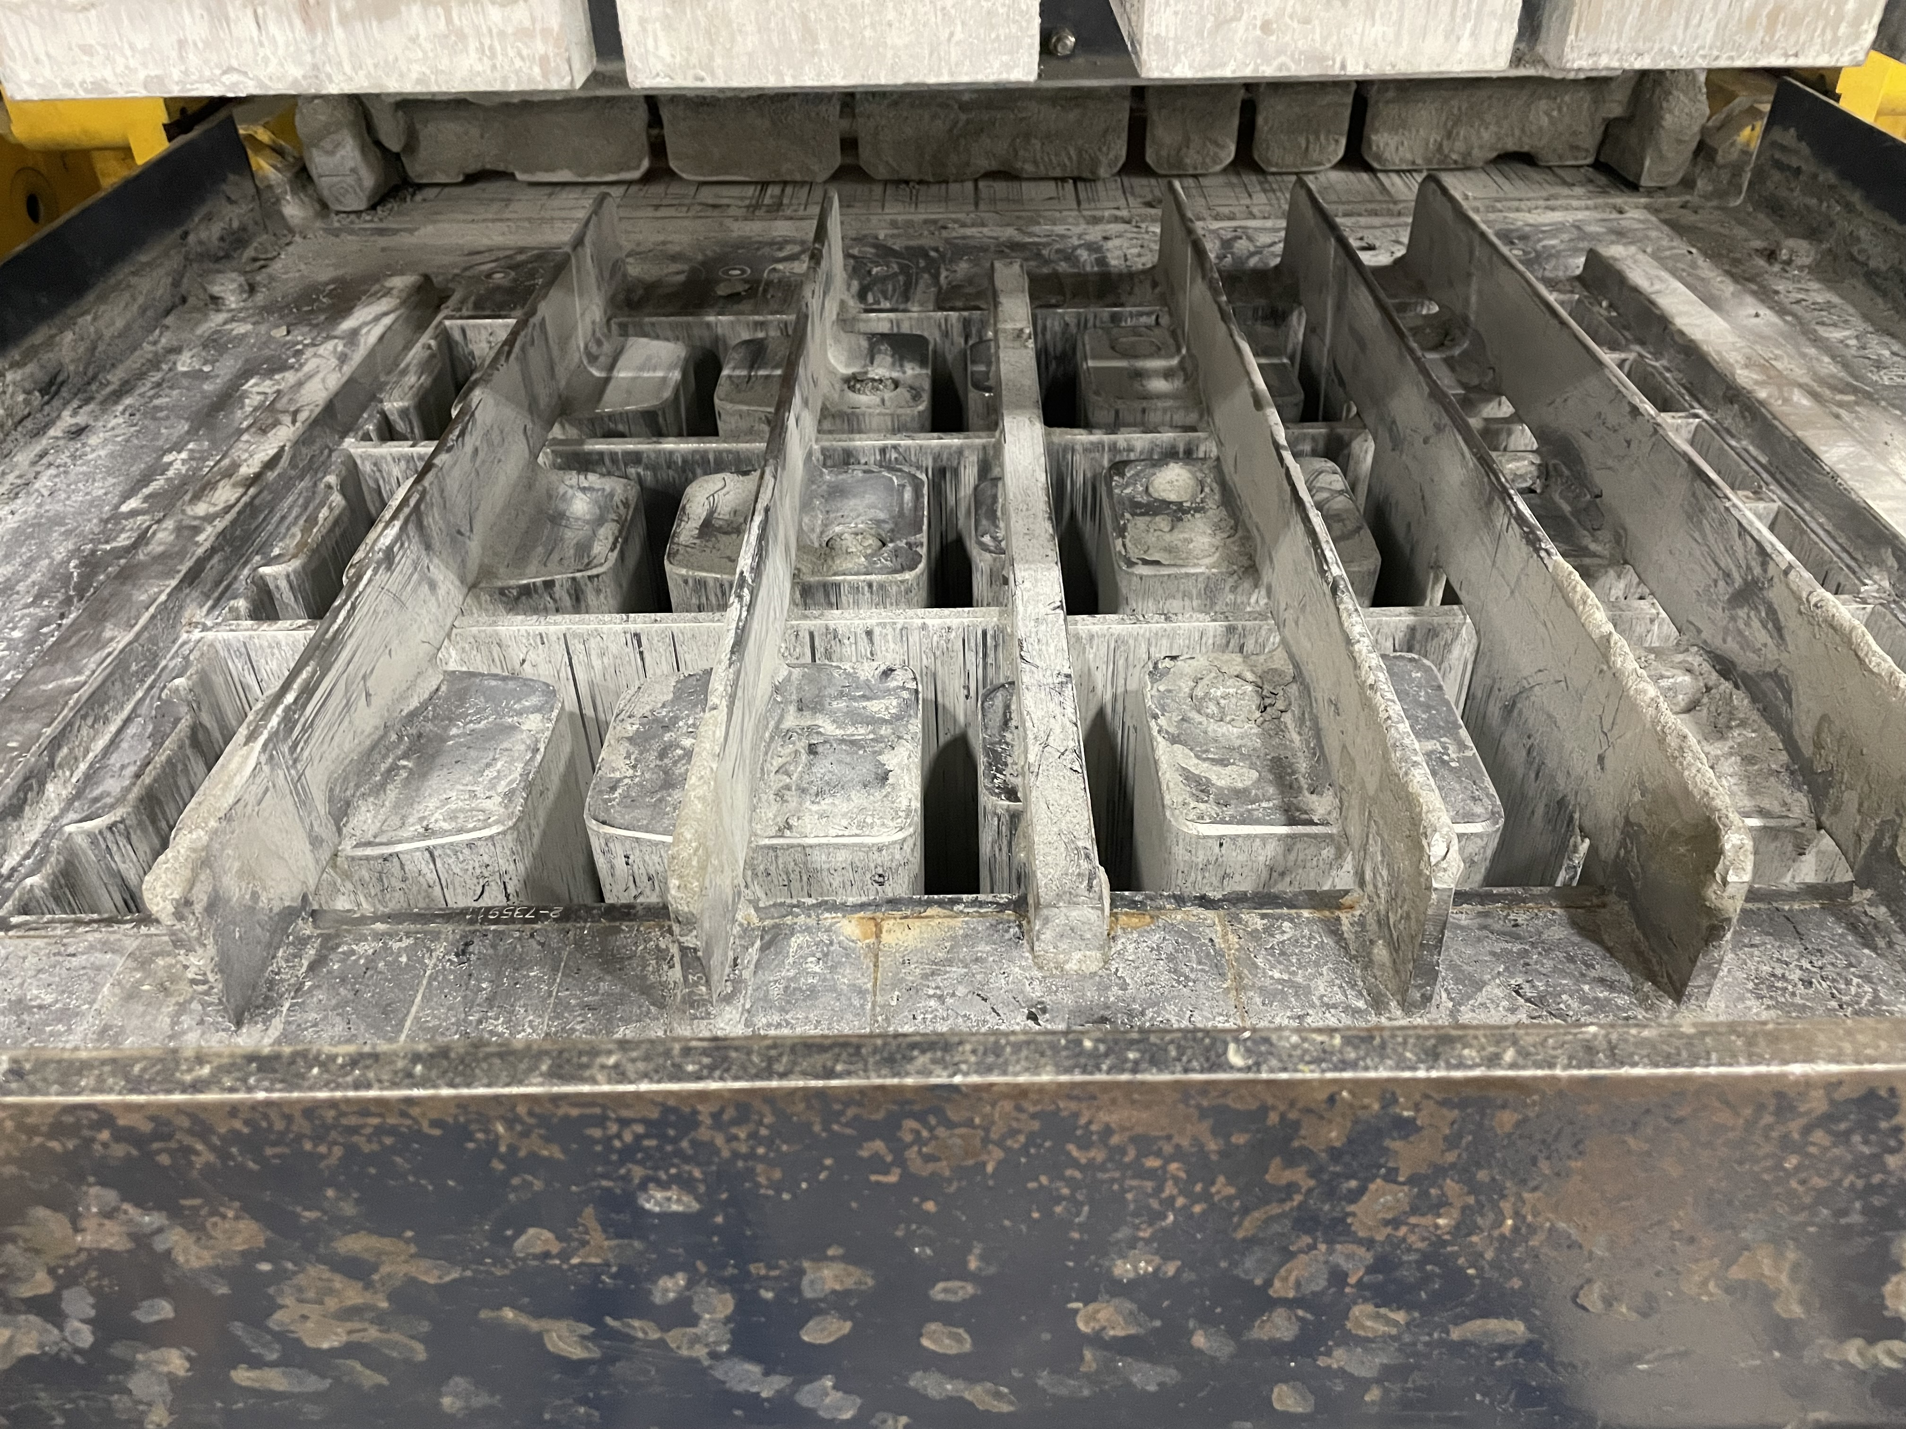
General Filling: Mold Material Build-Up
4. Take the air hose with the chisel extension and break apart all of the solid material stuck to any part of the mold. The finished state should look similar to Figure 10.
Figure 10

Slide 15

General Filling: Mold Material Build-up
5. Once this is done, hit “home and reset” (Figure 11), flip the control switch back to auto (Red circle in Figure 12), and hit the “Start Machine Cycle” button to run a couple of cycles to observe any improvement (Yellow Circle in Figure 12). If this does not improve, see Feedbox Material Build-up
Figure 11
Figure 12

Slide 16
General Filling: Feedbox Material Build-up
The feedbox may have dry material stuck inside, whether it be the agitators, the cutoff bar, etc.
1. Switch the control panel to “manual”, move the head up, and move the feedbox forward. Hold the button until the feedbox is no longer moving forward.
Figure 13

Slide 17
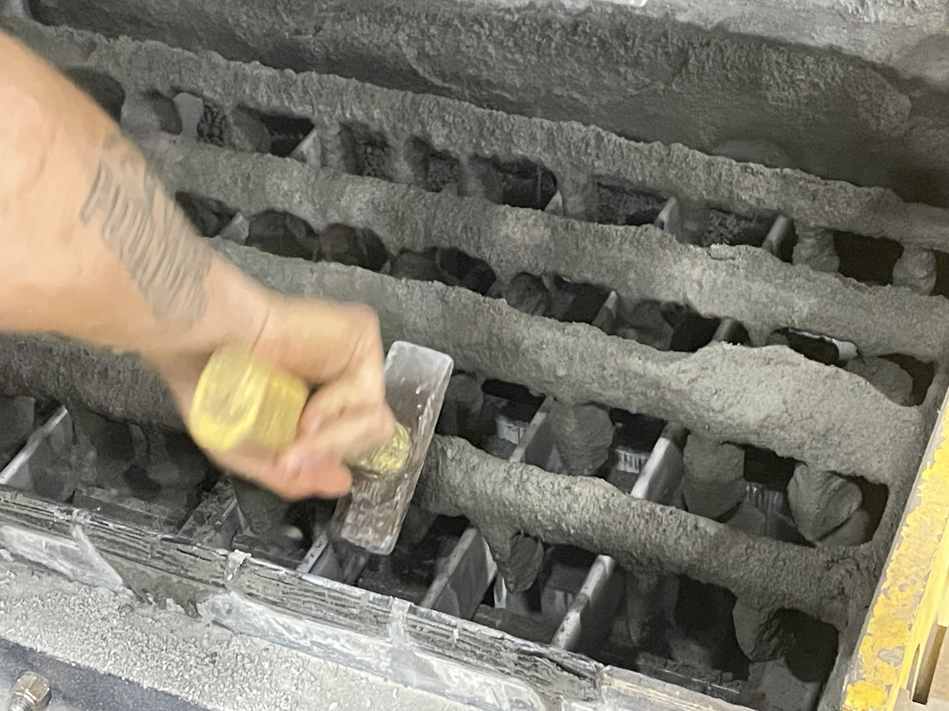
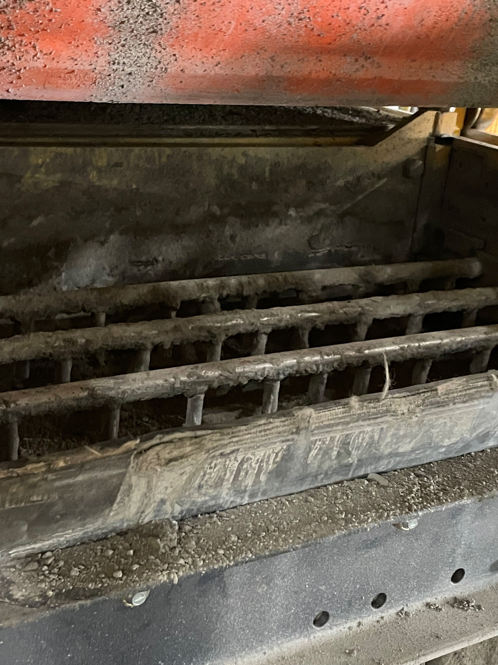
General Filling: Feedbox Material Build-up
2. Take a mallet and strike all five bars of the feedbox until most material comes off
- Figure 14a is an example of an agitator with built-up material and Figure 14b shows a clean agitator
Figure 14a
Figure 14b

Slide 18
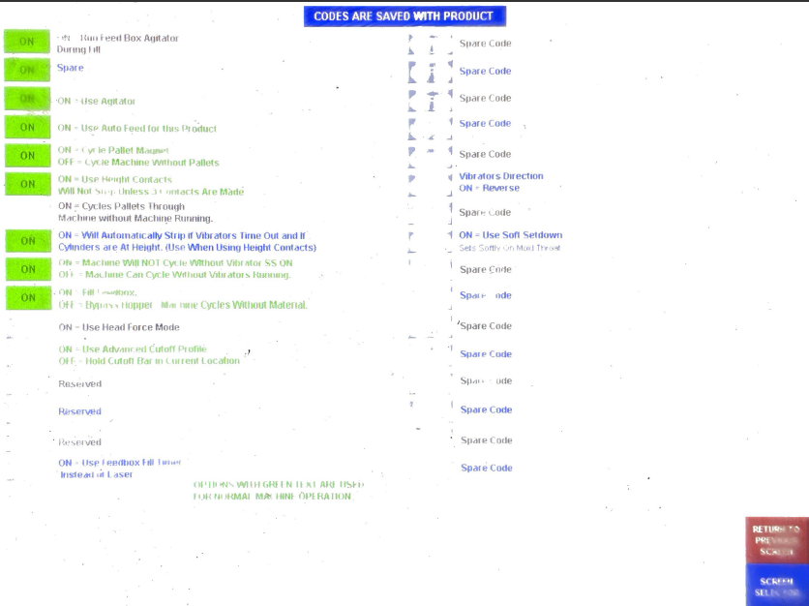
General Filling: Feedbox Material Build-up
3. All of the broken-up material will fall on the pallet below. Press the “Product Codes” button and Hit the “Off” button on the “Cycle pallets through” option, which will turn it to “On” (Red circle in Figure 15). Let the one pallet enter the front delivery and turn the option back off. Be sure to eject the pallet.
4. Run a couple cycles to observe any improvement. If not, proceed to the Core-bar Indentations
OFF
Figure 15

Slide 19
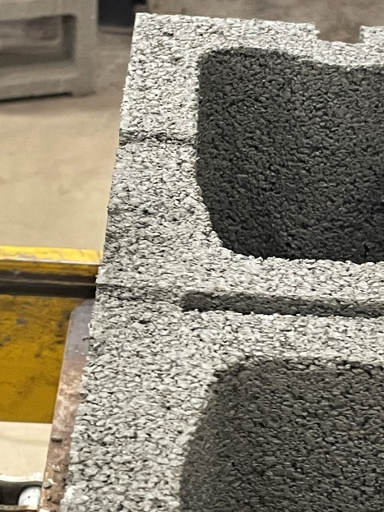
General Filling: Core-bar Indentations and Spillage
Sometimes, the tops of the blocks may have small indentations (Figure 16). This means that material is stuck to the bottom of the mold head
Figure 16

Slide 20
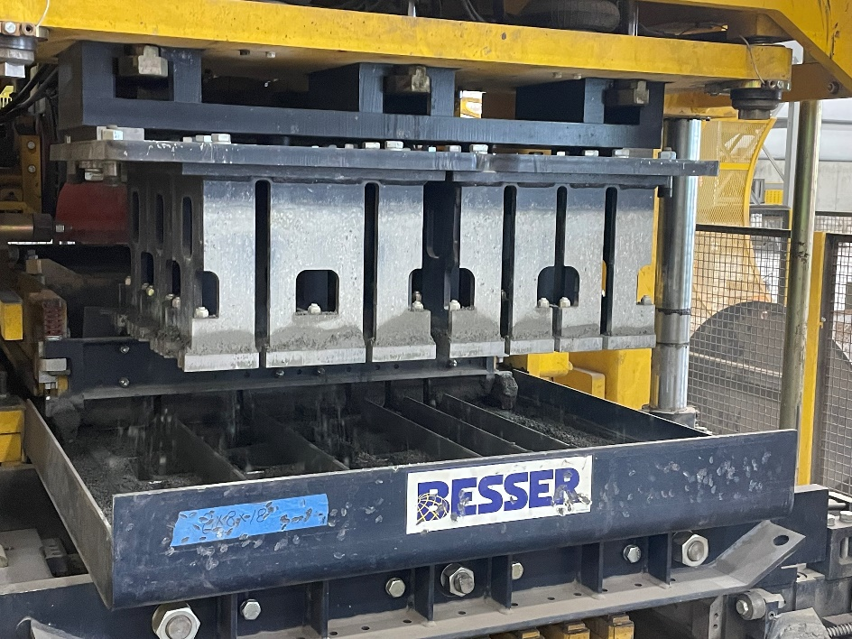
General Filling: Core-bar Indentations and Spillage
Take a metal rake and brush off the mold shoe (Yellow rectangle in Figure 14)
Figure 17

Slide 21
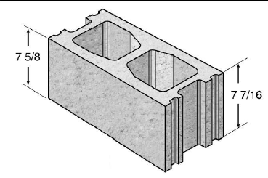
Out-of-spec heights
There may be times when one side of the pallet is higher/lower than the other side (Figure 18)
Figure 18

Slide 22
Out-of-spec heights
1. To determine which side is too high or too low, measure the block height of the pallet (See Block Height Documentation SOP). Determine which side is further out-of-spec and keep this in mind for the next step

Slide 23
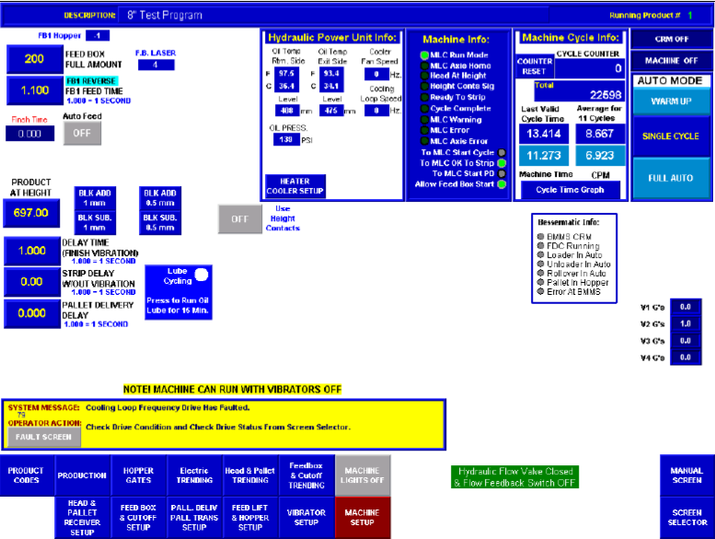
Out-of-spec heights
2. Go to the HMI Monitor. Open the “Head and Pall. Receiver” page (Red circle in Figure 19).
Figure 19

Slide 24
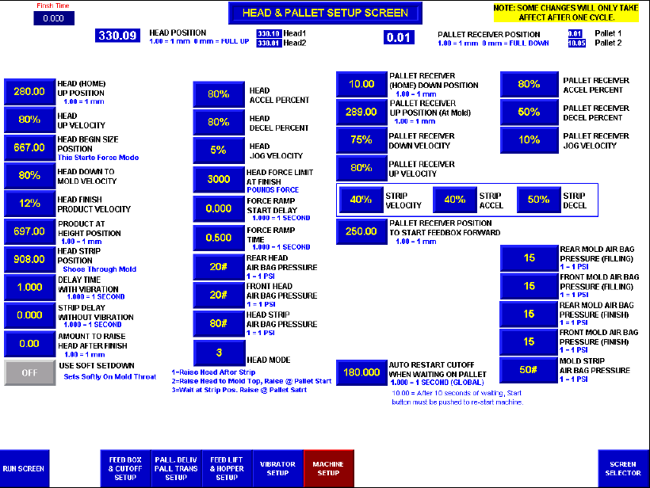
Out-of-spec Heights
2. Go to the “Head & Pallet Setup” page on the HMI monitor. Increase/decrease 1 psi from the pressure bags on whichever side is was determined to be more out-of-spec (Step 1)
a. Increasing psi raises height, while decreasing psi lowers the block height
3. Perform another measurement on a new pallet
Figure 20

